Slide 1
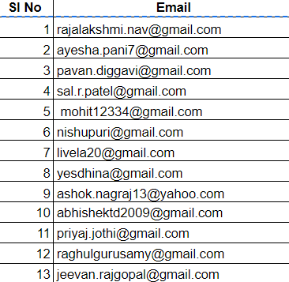
Capstone project - 1011

Slide 2
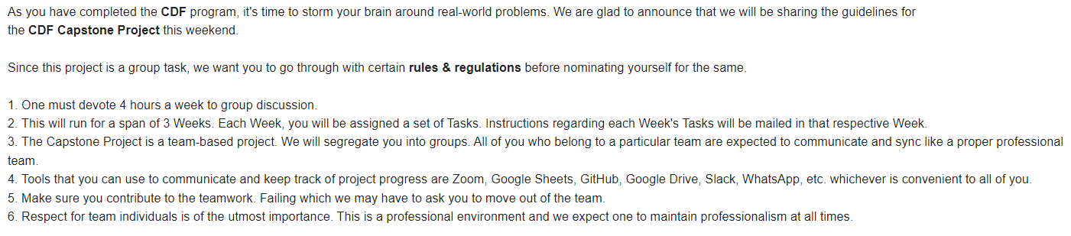
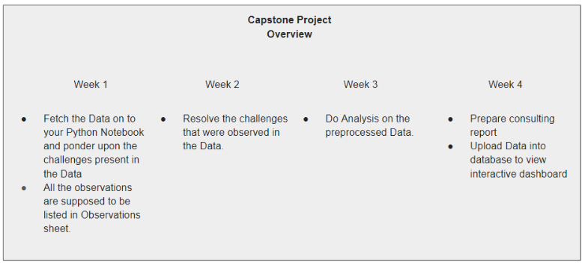
Project requirements
Group_id | Password
1011 | rtywd
Your Team details are present in Team Details.
Below are the instructions for the Tasks that are to be completed in Week 1:
1. Please visit the Capstone website and select Capstone Project on Data Analytics.
2. Login using the below credentials:
3. Once you login, you will find three tabs:
1. Project Description, 2. Consulting Goals, 3. Data Description
4. Go to 'Project Description' and read about the details of this Consulting Project that you will execute.
5. The Consulting Goals from the Customers have been laid in the 'Consulting Goals' tab.
6. To understand the Data and the corresponding Tables, please read through the 'Data Description' tab.
7. Fetch the Data onto your Python Notebook and ponder upon the challenges present in the Data.
8. All the observations are supposed to be listed in Observations.
Null values if present in the data should not be dropped at any cost. They should be filled using an appropriate method.

Slide 3
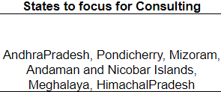
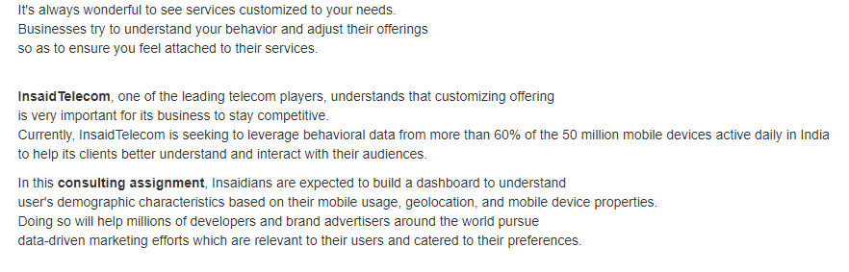
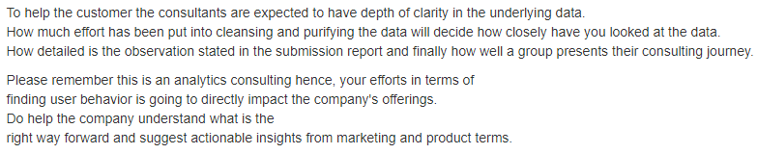
Project Description
Consulting Goals

Slide 4
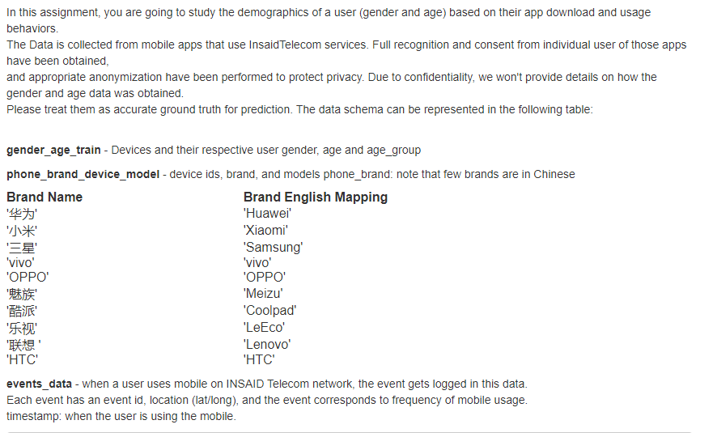
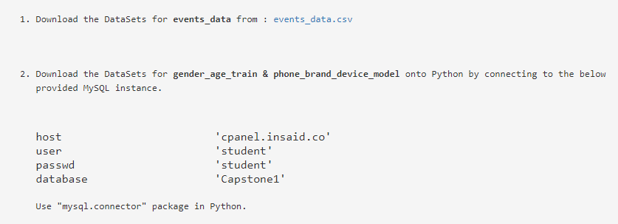
Data Description

Slide 5
Next Steps

